Slide 1


Elementary Photophysical Transitions and Photochemical Reactions
NSF REU June 09, 2023

Slide 2
Photochemistry’s
Icons
Why I am here.
From Photochemistry of Organic Compounds by Peter Klán and Jakob Wirz, 2009

Slide 3
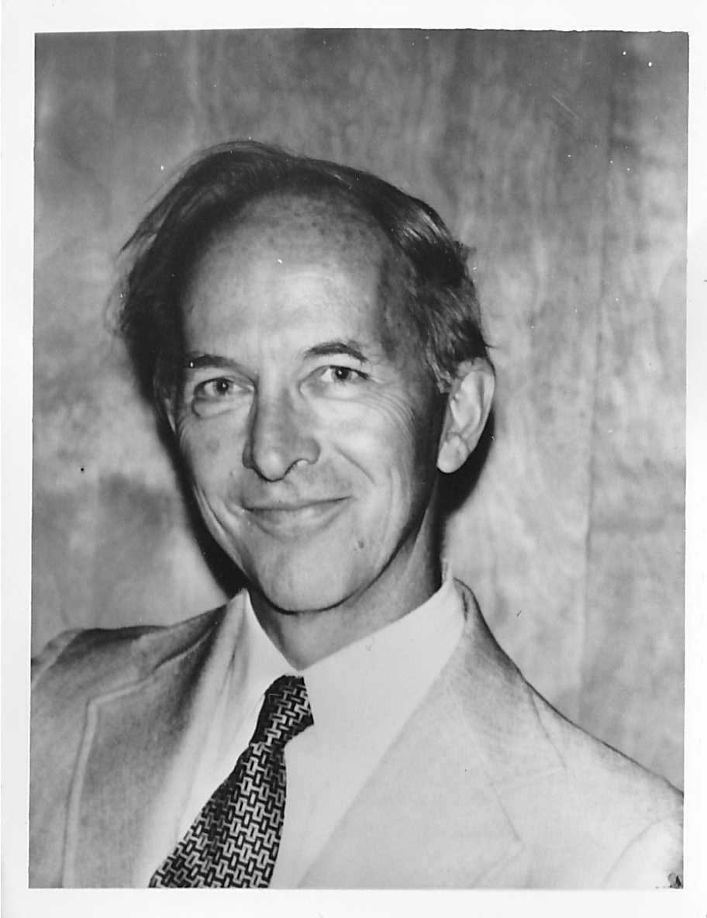
Photo by Lilli Kasha ca. 1970

Slide 4
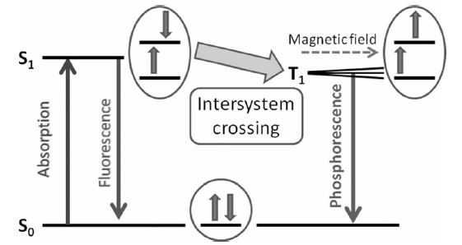
Intersystem Crossing
Demchenko, A. P. et al. Angew. Chem. Int. Ed. 2014, 53, 2-11.

Slide 5
Phosphorescence and the Triplet State
Gilbert N. Lewis , M. Kasha J. Am. Chem. Soc. 1944, 66, 2100-2116
Naphthalene phosphorescence – triplet energies

Slide 6
External and Internal Heavy Atom Effects
α-Chloronaphthalene
is yellow in EtI, JCP, 1952

Slide 7
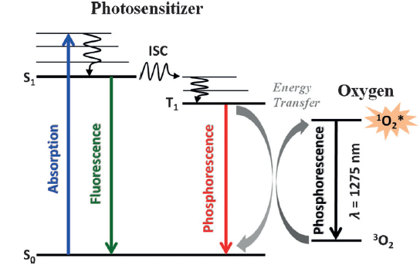
Singlet O₂ in Chemiluminescence and in Triplet Energy Transfer

Slide 8
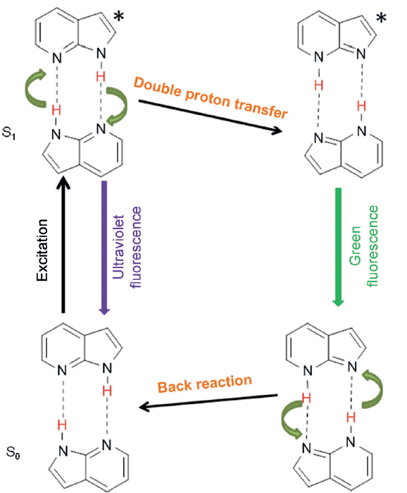
Double Proton Transfer in 7-Azaindole
Proton Transfer Spectroscopy

Slide 9
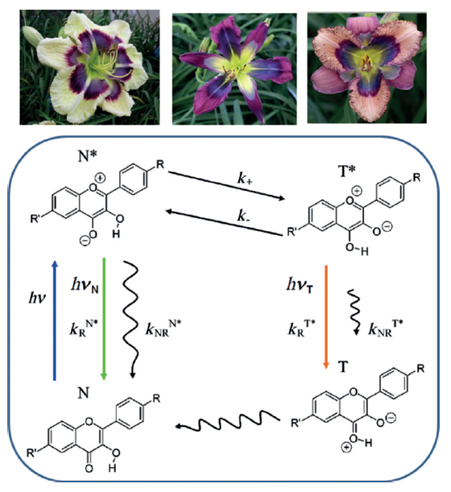
The Blue Daylily and Intramolecular
S₁ Proton Transfer in Flavonoids

Slide 10
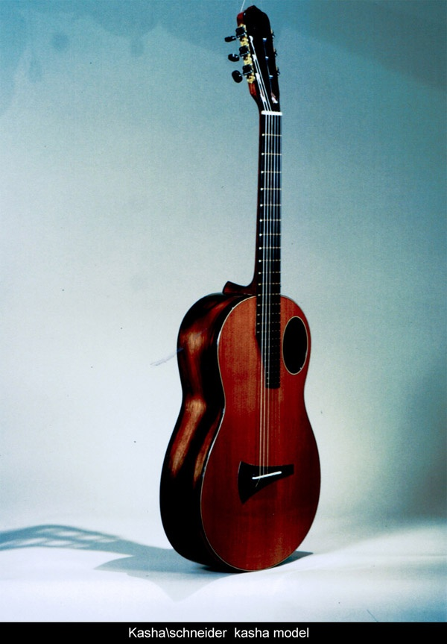
The Kasha Guitar

Slide 11
Triplet Sensitization

Slide 12
Triplet Sensitized Stilbene Photoisomerization
The Saltiel Plot
Hammond, G. S.; Saltiel, J. J. Am. Soc. Chem. 1962-1964.

Slide 13
The Photostationary State
¹t-St + ³S* → ³t* + ¹S*
³t*  ³p*
³p* → α¹t + (1-α)¹c
¹c-St + ³S* → ³c* + ¹S*

Slide 14
62 kcal/mol
57 kcal/mol
Vertical Excitation
49 kcal/mol
Vertical Excitation
5 kcal/mol

Slide 15
Nonvertical Triplet Energy Transfer

Slide 16
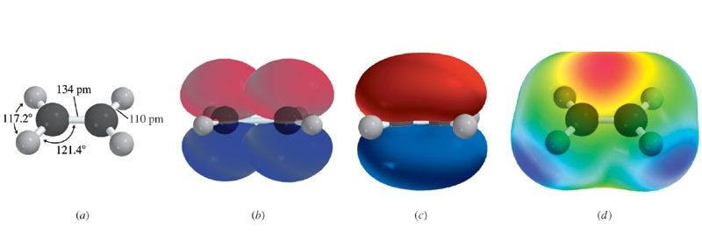
Average bond energies
C-C 83 kcal/mol
C=C 146 kcal/mol
π bond ~ 63 kcal/mol

Slide 18
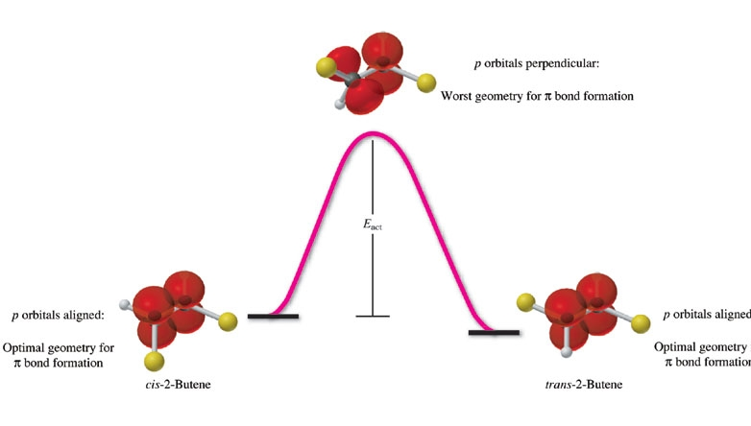
cis- and trans-2-butenes are stable separable isomers.
They have the same connectivity and are stereoisomers.
Rotation about a double bond occurs only at very high T
or following light absorption.
π bond ~ E­_{act} = 66 kcal/mol

Slide 19
Spin States αα, ββ, √1/2 (αβ + βα), √1/2(αβ − βα)
T T T S

Slide 20
Absorbance
n | λ­_{max}, nm | ε_{max} x 10⁻³, M⁻¹cm⁻¹
1 | 294.1 | 28
2 | 328 | 53
3 | 348 | 80
4 | 404 | 86
Effect of Conjugation

Slide 21
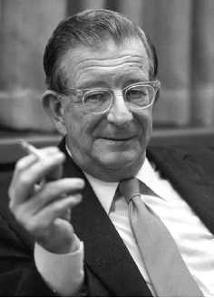
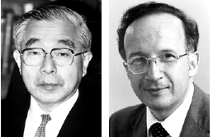
Molecular Orbital Analysis of the Diels-Alder Reaction
The diene is the electron donor and the dienophile is the electron acceptor.
The concerted nature of the D-A reaction can be understood by
considering the interaction of the HOMO of the diene with the LUMO of
the dienophile (Fukui/Kyoto, Woodward/Harvard, Hoffmann/Harvard
now Cornell---Nobel prize in Chemistry)
1965 1981

Slide 23
Frontier Orbital Control of Diels-Alder Reaction
HOMO Donor
LUMO Acceptor

Slide 24
Electrocyclic reactions are stereospecific

Slide 25
Rotation in the same direction leads to a bonding interaction
(+ lobe on + lobe or - lobe on – lobe). The reaction passes through
the same TS in both directions.

Slide 26
Rotation in opposite directions leads to a bonding interaction
(+ lobe on + lobe or - lobe on – lobe).
The reaction passes through the same TS in both directions.

Slide 27
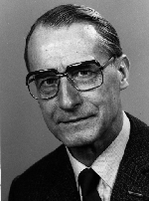
NEER PRINCIPLE
Havinga, Tetrahedron, 1973
φ_{ct} = 0.03, φ_{tc} = 0.016
Egbert Havinga
1909-1988
Havinga, E.; Schlatmann, J. L. M. A Tetrahedron 1961, 16, 146-152.
NEER, Havinga
27
Havinga, E.; Schlatmann, J. L. M. A Tetrahedron 1961, 16, 146-152.

Slide 28
1,6-Dideuteriohexatrienes
ttt-Ht_{d2} in C₆D₁₂
ctt-Ht
cct-Ht
 | C₆D₁₂ |  | CD₃CN
x | φ_{ttt→x} | φ_{tct→x} | φ_{ttt→x} | φ_{tct→x}
ctt | 0.44 | 0.24₅ | 0.54 | 0.24
cct | 0.08₅ | 0.34 | 0.09₃ | 0.39
tct |  |  | 0.01₄
ttt |  | 0.05₈ |  | 0.11
Saltiel, J.; Redwood, C. E.; Laohhasurayotin, K.; Samudrala, R. Photochemistry
of the 1,6-Dideuterio-1,3,5-hexatrienes in Solution: J. Phys. Chem. A 2018, 122, 8477-8489.
28

Slide 29
PreVit D Conformers
Havinga’s NEER Principle
Egbert Havinga
1909-1988
Photocyclization
Long λ
Photoisomerization
Short λ
29
Saltiel, J.: Cires, E.; Turek, A. (2004) CRC Handbook of Organic Photochemistry and Photobiology,
2nd Edition (Scheme 1, p. 27-2)
29

Slide 30

NPE conformers
NPE Conformers

Slide 31
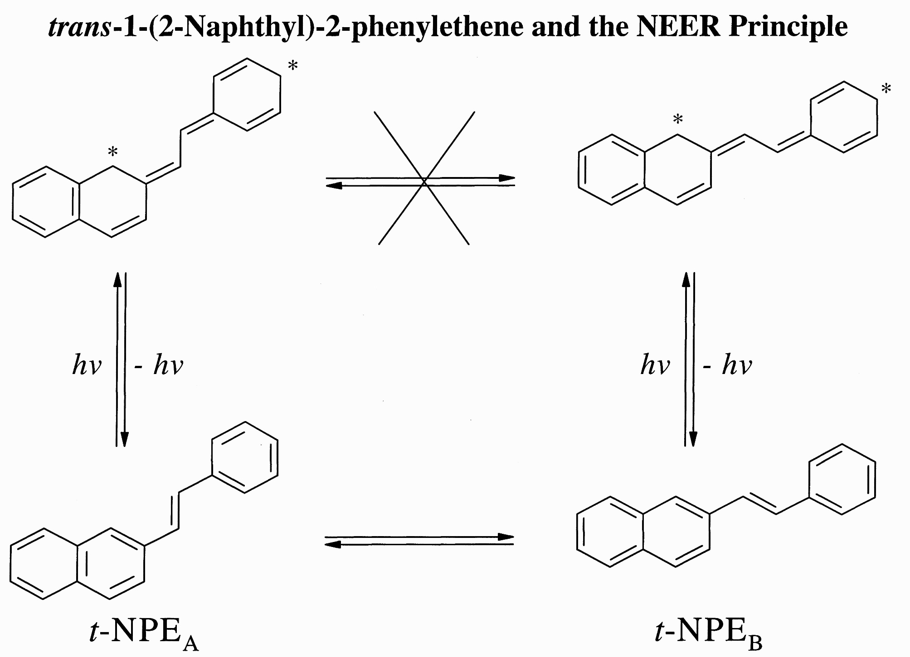

Slide 32
Conformer specific photochemistry in c- and t-NPE

Slide 33

t-NPE/Bz

Slide 34
Summary of PCA-SM Mathematical Operations
Transposed
Matrix
Spectral Input
Matrix
Covariance
Matrix
x
=
⇓
Number of
Components
⇐
Eigenvalues
⇐
Diagonalized Matrix
Eigenvectors
⇐
Eigenvector Matrix
α_{i} = V_{α} ⋅S_{i}, β_{i} =V_{β}⋅S_{i}
S_{i} = α_{i}V_{α} + β_{i}V_{β}
Pure Component Spectra
S^{A} = α^{A}V_{α} + β^{A}V_{β}
S^{B} = α^{B}V_{α} + β^{B}V_{β}
Experimental Spectra
S_{i} = α_{i}V_{α} + β_{i}V_{β}
Pure Component Coefficients
α^{A}, β^{A} and α^{B}, β^{B}

Slide 35
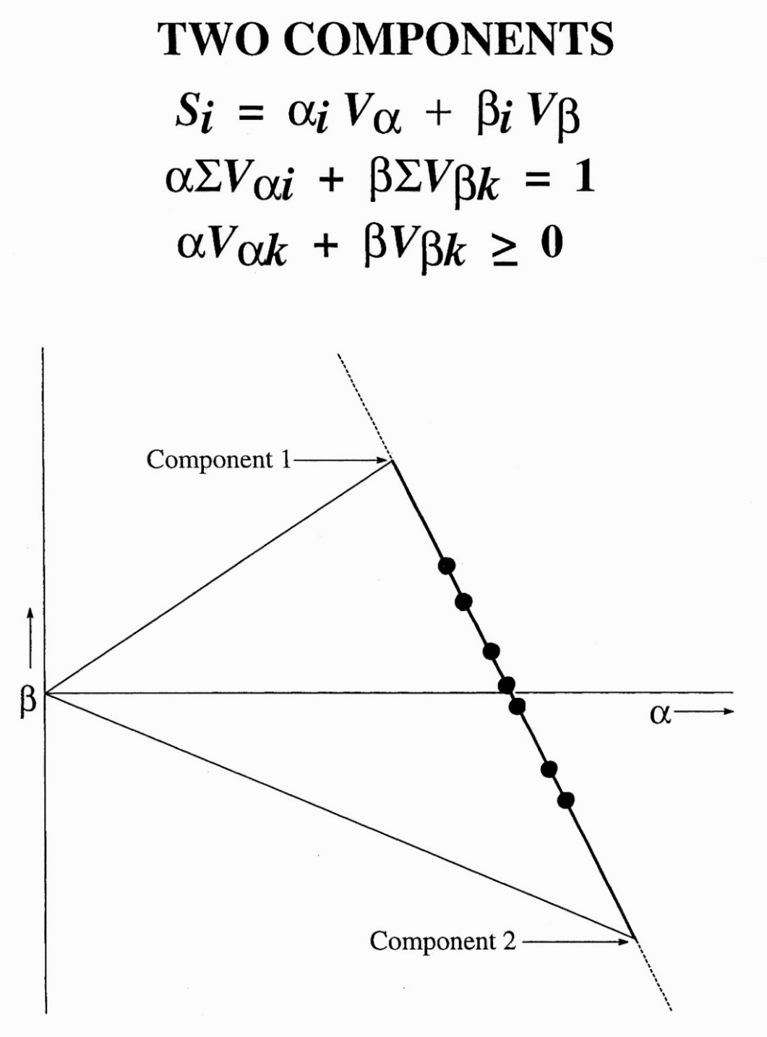

Slide 36
t-NPE/PCA-SM
Principal Eigenvectors
α − β
Plot
Standard Deviation
0.125
0.0
0.1
0.2
0.3
0.015
0.065
0.009
0.005
Normalized Intensity
-0.055
0.003
β
-0.115
-0.003
-0.175
330
350
370
390
410
430
450
470
490
510
-0.009
, nm
λ
0.0500
0.0775
0.1050
Global Stern-Volmer Plots
Conformer Spectra
α
3.0
1.0
t-NPE_{A}
0.8
t-NPE_{B}
t-NPE_{A}
2.0
t-NPE_{B}
Φo /Φ
0.6
Normalized Intensity
0.4
1.0
0.2
0.0
0.0
[O₂]/M
-0.0004
0.0013
0.0030
0.0046
0.0063
0.0080
330
350
370
390
410
430
450
470
490
510
λ
, nm

Slide 37
S-V Kinetics
Stern-Volmer Quenching
Equation | Rate
¹A + hν_{exc} → ¹A* | I_{a}
¹A* → ¹A + hν_{f} | k_{f}[¹A*]
¹A* → ³A* | k_{is}[¹A*]
¹A* → P | k_{p}[¹A*]
¹A* + Q → ¹A + Q* | k_{q}[Q][¹A*]

Slide 38
The Stern-Volmer Plot
where I_{a} is the rate of light absorption

Slide 40
Benzophenone State Diagram

Slide 41
El-Sayed’s Rules for Intersystem Crossing

Slide 46
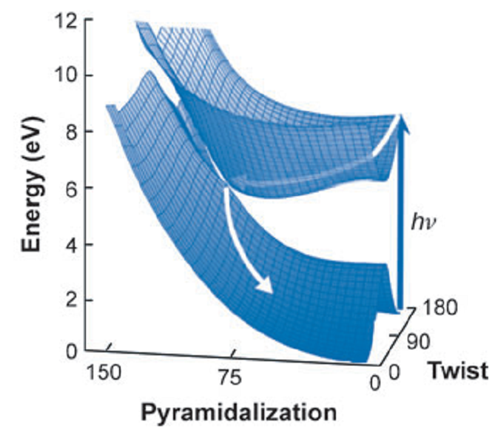
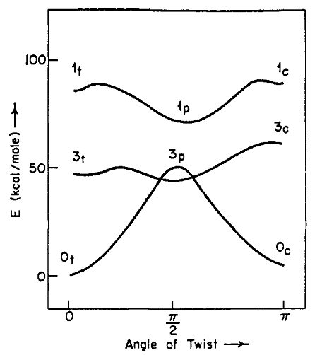
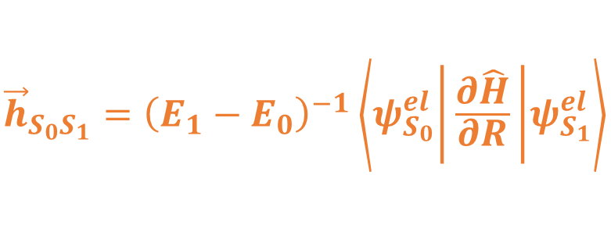
Multidimensional Isomerization – Conical Intersections – Trapping Twisted Intermediates
$${\vec{h}}_{S_{0}S_{1}}={\left(E_{1}−E_{0}\right)}^{−1}\left\langle ψ_{S_{0}}^{el} | \frac{∂\hat{H}}{∂R} | ψ_{S_{1}}^{el}\right\rangle$$
Saltiel, J.; Gupta, S. Photochemistry of the Stilbenes in Methanol. Trapping the Common Phantom Singlet State. J. Phys. Chem. A 2018, 122, 6089-6099.
B. G. Levine, T. J. Martínez. Annu. Rev. Phys. Chem. 2007, 58, 613-34.

Slide 47
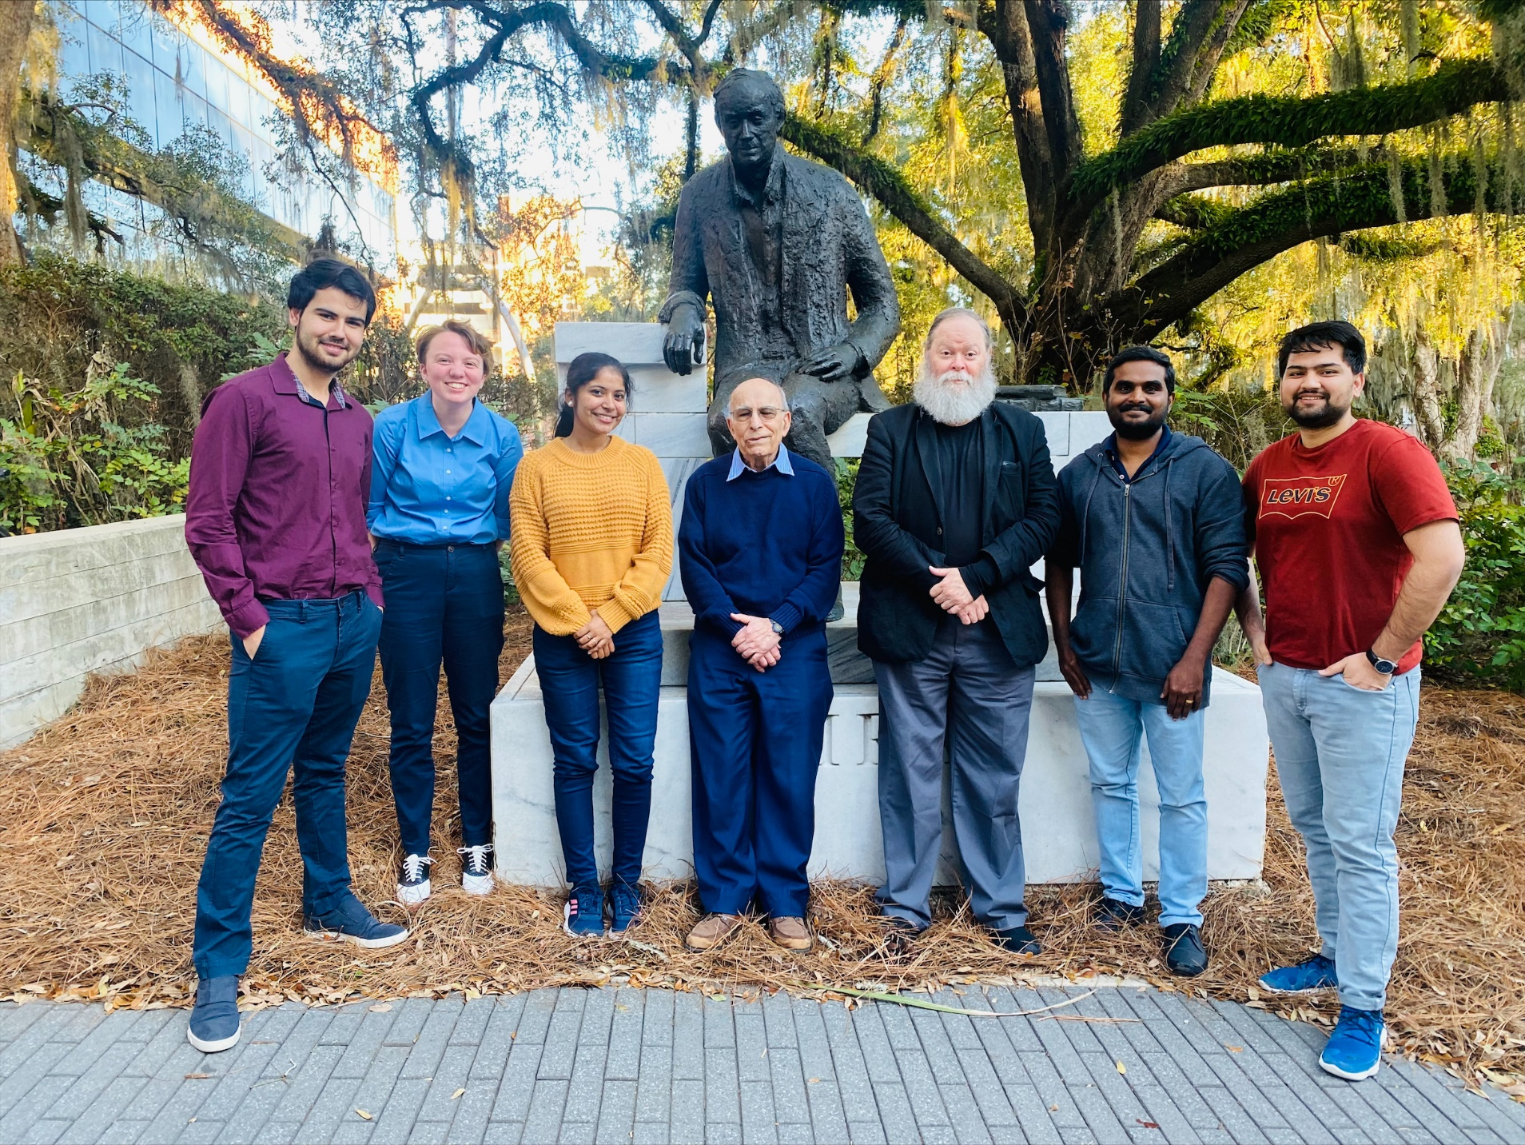

Slide 48
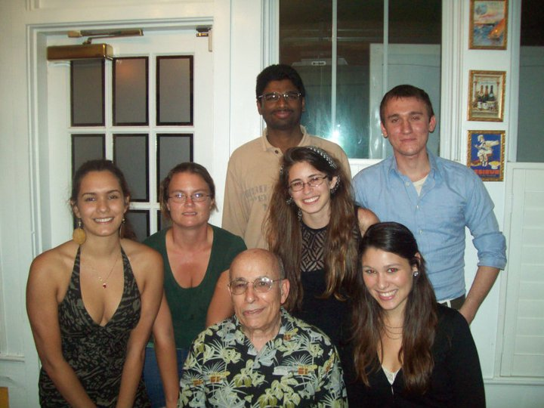
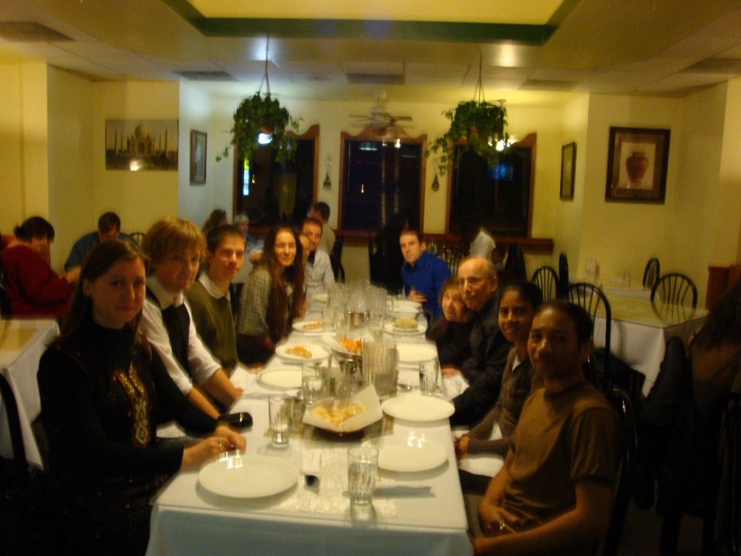
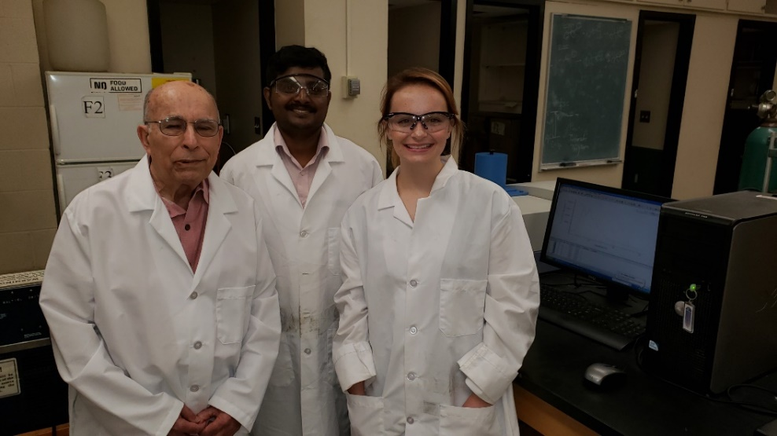
Acknowledgments
PCA-SM
C. Redwood
L. Zimanyi
Experimental
Gosia Bayda,
Shipra Gupta
Sumesh Krishnan
Support
NSF (1965-2020)
48
Acknowledgments

Slide 51
The Saltiel Plot for Stilbene Triplet Photoisomerization

Slide 52
1,3-Diene Triplets: Conformer Specific Photoisomerization and Photodimerization
Fluorenone sensitized photoisomerization
57 kcal/mol
52 kcal/mol
59 kcal/mol
Not present

Slide 53
1,3-Diene Triplets: Conformer Specific Photoisomerization and Photodimerization
Fluorenone sensitized dimerization

Slide 54
Saltiel Plots
1,3-butadiene dimerization
dashes
1,3-pentadiene E,Z isomerization
solid line

Slide 56
Heptane - - -
Water

